Slide 1
Summer 2024 Project: Content Evaluator
Michelle Han
Notes:
Concisely write topic of project
General overview

Slide 2
Overview
Current problems
ATS foundation
Grammarly
Project steps
Logistics
Obstacles

Slide 3
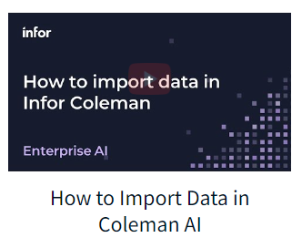
Current Issue
Inconsistency with information on Developer Portal
Many components to oversee
Unclear guidelines
More future content to be added
Outdated current information
Example: Coleman AI

Slide 4
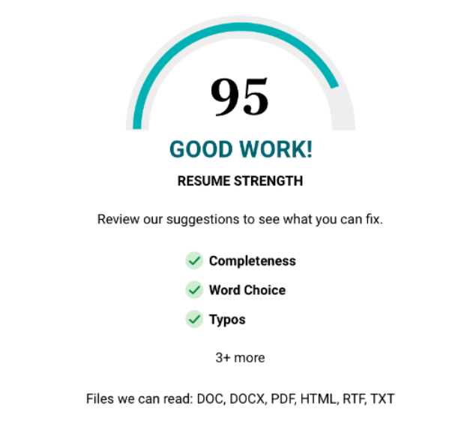
Application Tracking System (ATS)
Commonly used to process countless applicants’ CVs
CVs are parsed/scanned
ATS weeds out CVs without keywords pertaining to desired skills
Oftentimes, AI powered

Slide 5
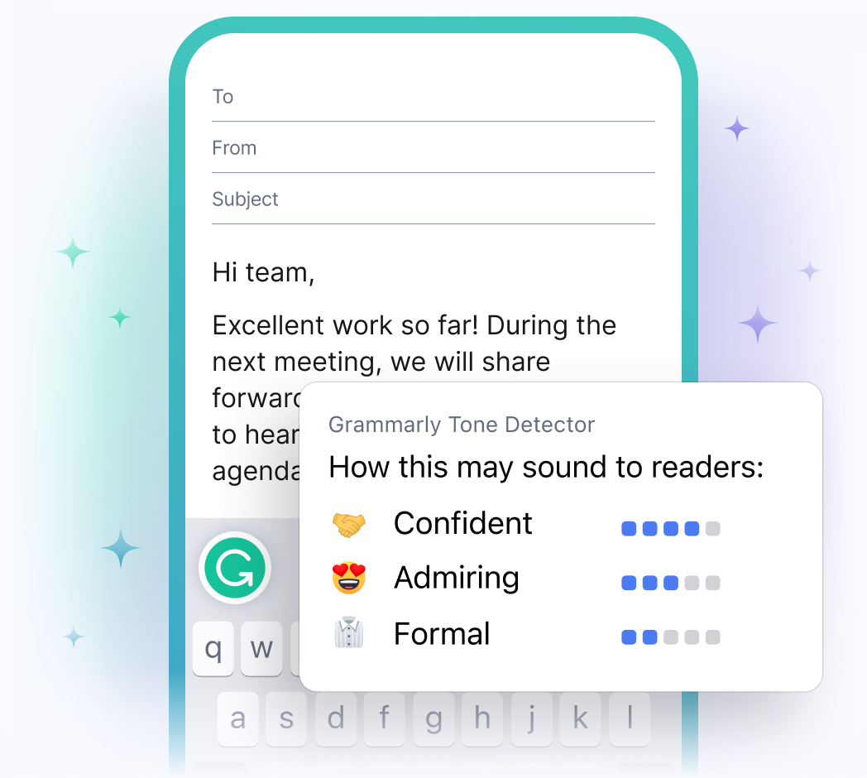
Think Grammarly
Specific to InforOS & Developer Portal
Ultimate goal: provide feedback similar to Grammarly

Slide 6
Current Steps
Research AI models
Explore deep learning and NLP
Start building
Goals:
Enforce uniformity for existing and future content
Update/Remove outdated content
Use Jupyter Notebook
Understand how and why they work
Read files & store text

Slide 7
Potential Logistics
AI Model: combination of GenAI and Predicative AI
GenAI: generates the comments/feedback
Predicative AI: generate new rules/guidelines for potential scenarios
Input: any .txt, .pdf, and .docx (possibly) files
File is converted and text is extracted
Output: writing to a file, comments or a short list of edits to be made
Ambition: having the ability to markup the file, like a human would when reviewing documents

Slide 8
Potential Obstacles
Learning curve (AI models, training, etc.)
Time
Difficult to define the rules and guidelines
May not be enough test cases to train the model
Encountering new situations, how does the model adapt?
Costs:
Maintenance
Is this even worth it?

Slide 9
This week:
Continue research and explore different models
Focusing on Sentiment Analysis and Transformer Models (BERT)

Slide 10
Thank you!

Slide 11
Steps
Create a custom algorithm
Content guidelines are used as “rules”
Train an AI model using this algorithm
Goals:
Enforce uniformity for existing and future content
Update/Remove outdated content
Use AI, Jupyter Notebook, or VSCode

